Slide 1
Motivation of cover letter
FA.Iskakova

Slide 2
A plan
What a Motivational Letter Is (And Why It Matters)
How to Structure a Motivational Letter
How to Write a Motivational Letter [+Some Helpful Tips to Get Those Ideas Out of Your Head and Into the Paper]

Slide 3
Definition the term “Motivation letter”
A motivational letter or a personal statement, is a short piece of writing all about you: your past, your ambitions, your personality, and your interests.
While completing CVs and forms can be a little dry and boring, motivational letters can be hard to write.
The combination of needing to produce such an intimate (private) piece of writing, worded in such a way that it comes across as both authentic and professional, and then using it to sell yourself to a university or a company or other job places is nerve-wracking.

Slide 4
What is a Motivational Letter and Why it Matters?
A motivational letter is a one-page letter that’s used to describe why you are the perfect candidate for a certain position.
It is usually attached to your resume
it’s a fundamental skill in today’s jobs market – once you leave full-time education, you’ll need to write motivational letters to potential employers.

Slide 5
What is a Motivational Letter and Why it Matters?
You are required to write a motivational letter in these 4 specific scenarios...
You are applying to get admitted to an educational program at a college or university (undergraduate, graduate, or postgraduate).
You are applying to work at a non-profit organization.
You are applying as a volunteer in an organization.
You’re applying for an internship in a company.

Slide 6
How to Structure a Motivational Letter
A good motivational letter is a one-pager where you introduce yourself, your story, and show your interest in the position or organization you are applying to.
There are two main ways to structure your motivational letter:
Using the classic 3 main paragraphs structure, where your motivational letter has the introduction, the body, and the conclusion.
Using the 5-7 paragraph structure, where you divide your main body paragraph into smaller 1-3 sentence paragraphs according to the main points.
if you want to be more factual and to the point, go for the 7-paragraph structure. This way, you can use each body paragraph to discuss specific achievements or points.
If, on the other hand, you’re going for a more story-telling approach, you’d go for the 3 paragraph option, so as not to break the flow of the story.
a Paragraph - is a unit of writing in a larger body of work, and expresses a particular topic or theme.

Slide 7
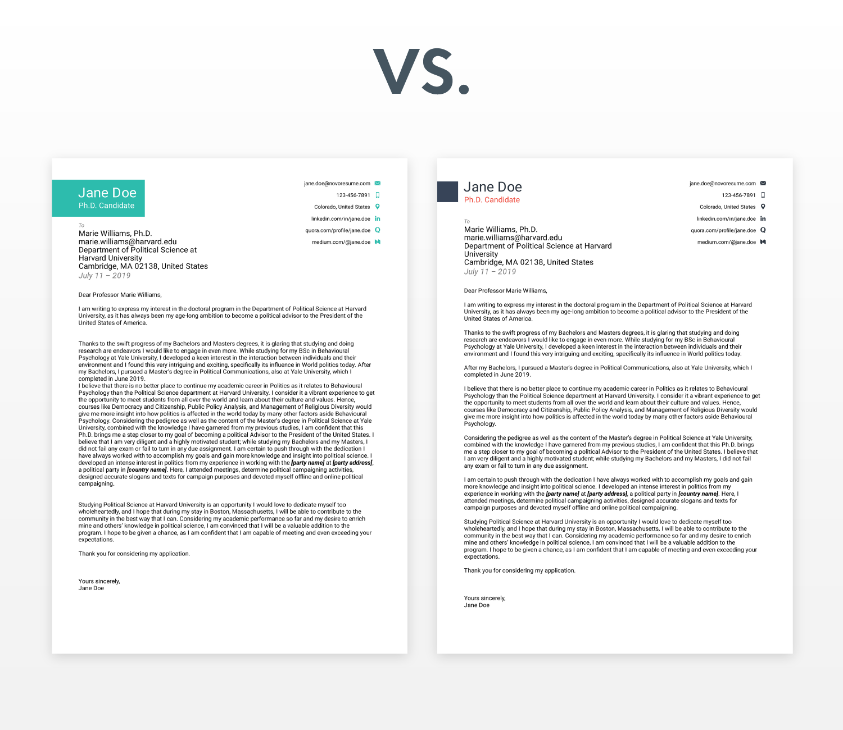

Slide 8
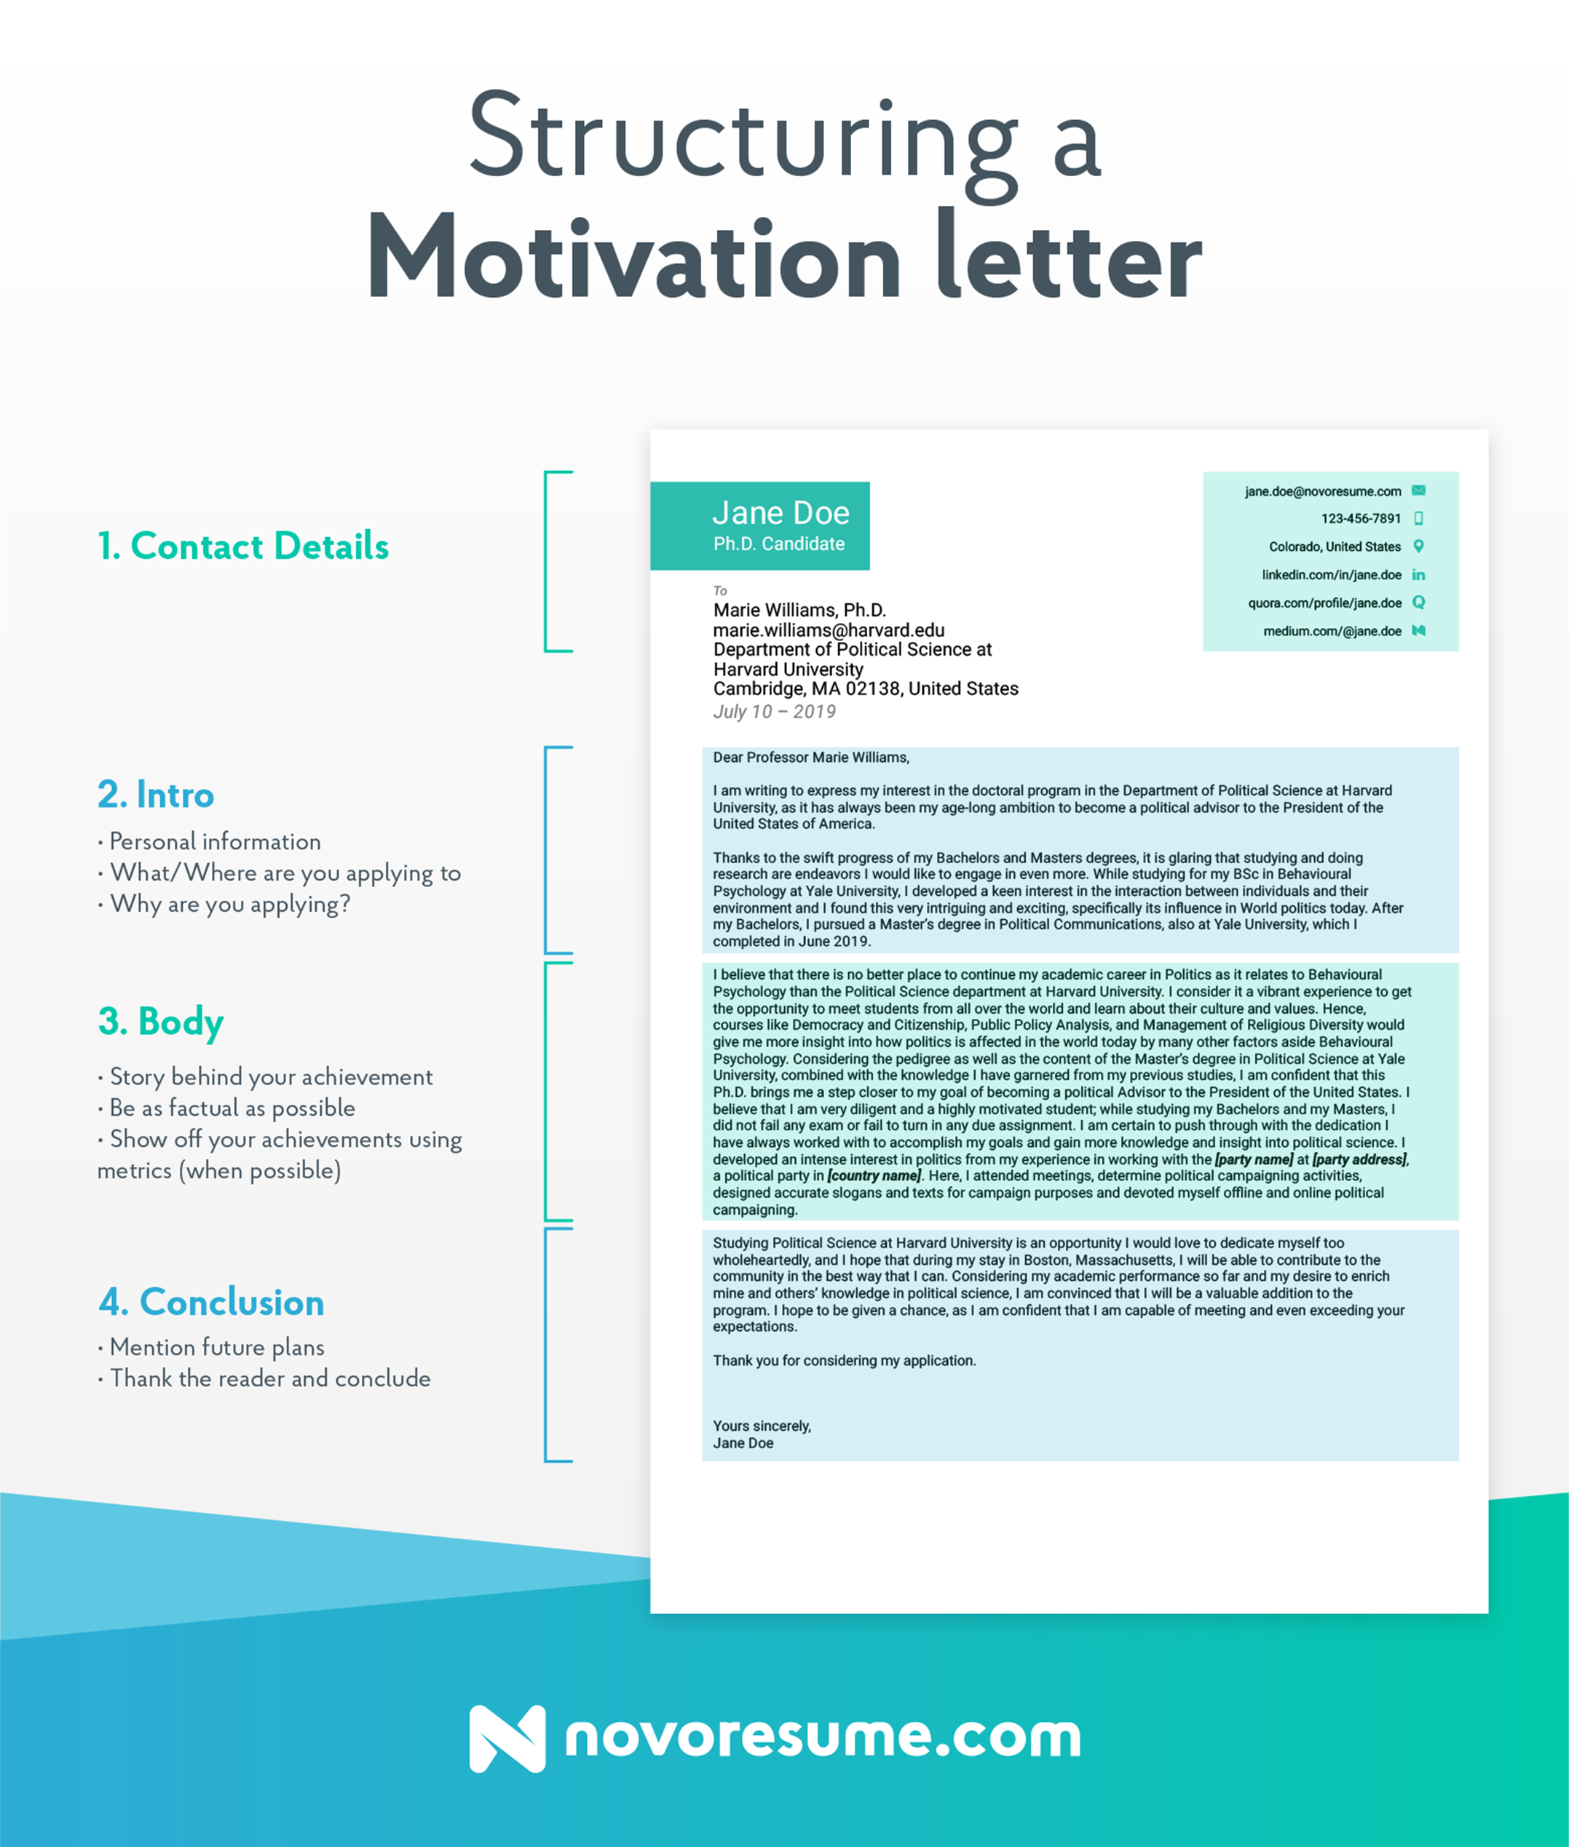

Slide 9
Introduction
It is a short, engaging pitch about yourself and why you are applying
Contact information on top.
For example:
To: School/Organization Name
First Name Last Name
myemail@mail.com
Phone Number
Relevant Social Media (LinkedIn, Quora, GitHub, etc.)
Introduction parts:
Personal information. Who are you and what do you do?
What are you applying for? Where?
An intro to the bulk of your essay. Mention the general reason on why you’re applying, and then deep-dive in the bulk of your motivational letter.

Slide 10
Example of Introduction for Motivational Letter
Dear [Name of The Contact Person],
My name is [Your name] and I would like to express my interest in applying for the Doctoral program in political science at [University Name].
I’ve always dreamed of becoming a politician and helping give back to my country, and I believe that a Ph.D. in politics from [University Name] would set me miles ahead to reaching my goal.

Slide 11
Body of the Motivational Letter
Body of the Motivational Letter: this is the main bulk of your motivational letter. This is where you really sell yourself, mentioning stories behind your achievements, skills, and passion for whatever you’re applying for.
Try to be as factual as possible - anyone that frequently reads motivational letters can tell made-up stories from the real ones. When possible, you can also use metrics to back up your qualifications.
Try to be as factual as possible - anyone that frequently reads motivational letters can tell made-up stories from the real ones. When possible, you can also use metrics to back up your qualifications.

Slide 12
Practical Example
Things You Can Mention in Your Motivational Letter:
My passion for ______ started when ______.
I want to ______ because ______.
I have been part of _________ for ___ months/years. It’s the best thing for me because _______.
I remember once when I ________, which made me realize that I _______.
_______ resonates with me because _________.
What distinguishes me from my peers is __________.
a Practical Example:
I developed my passion for Online Marketing during my internship at [company name]. Working in a small startup allowed me to get surface-level experience in most digital marketing channels. Now, I would like to deep-dive and gain advanced know-how by attending the [university name] program in Digital Marketing.

Slide 13
Conclusion
Finally, you can wrap up the motivational letter and send it in. In this section, you can:
Briefly summarize your main points - “I believe I’d be a good fit for the program because of __________”
Mention your overarching goal - “I’d love to be a part of _______, as it would allow me to ___________.”
Thank the reader and conclude the motivational letter

Slide 14
How to Write a Motivational Letter
So how do you write a motivational letter that stands out from the pool of applicants? The way to avoid generalizations and add depth to your motivational letter is by tailoring it to the specific organization and program/position you are applying to:
When writing a motivational letter, you want to make sure you know what and where you are applying to. Find out who is in charge of deciding your fate and address them directly in your opening remarks as Dear Mrs. Smith.
Look at the program requirements and the institution’s website. Find out the top three requirements for the position and explain how you are the best candidate.
Demonstrate that you share the organization’s values or are exceptionally qualified through a short story or personal examples. Be specific.
Your motivational letter should demonstrate that you really want to be there! There is a fine line between pleading and showing intelligent interest while also selling yourself. State specific reasons, demonstrate knowledge and express passion for applying to the institution or organization without showing off or begging.
DO NOT LIE! If you write anything remotely untrue, your reader will sense it. Unconsciously, we inflate feelings and ideas when we lie. If you tell a fake story or inflate your excitement or achievements, you will be put into the “lying Pinnochio pile”. Consider your case rested and your application denied.

Slide 15
Conclusion
So, let’s sum up everything we’ve covered in this post:
A motivational letter is a formal letter which you need to write if you’re applying for university/college admissions, a non-profit, or a volunteering institution. Job applications usually require a cover letter instead.
There are two ways to structure a motivational letter: in three paragraphs (introduction, body, conclusion) or in 5-7 paragraphs (where each paragraph highlights a different point).
Introduce yourself and your intent in the introduction, describe and highlight your experiences in the body, and thank the reader for his/her consideration in the conclusion.
Do your research, show genuine interest, and never, ever lie.
If you want your motivational letter to stand out, Novorésumé takes the cake!
A motivational letter is always attached to a resume. Want to also make that stand out from the rest?

Slide 16
QUESTIONS TO ANSWER IN YOUR MOTIVATIONAL LETTER [+Possible Answers]
What attracted you to this specific organization or program?
I would love to live in [location of organization], because ________.
It is my dream to be part of [name of program], because _________.
What are the values the institution is based on and how do you share them?
The values [name of institution] is based on are: [three general values stated on their website]. I have demonstrated _____ because I have ______ especially in ______. I also practice ______ in my professional or working life by __________.
What kind of applicants are usually admitted to the program and why do you fulfill the requirements?
Requirement: Minimum 2 years of volunteering experience
I volunteered in Africa for three years. It’s one of my most fulfilling experiences because I am passionate about helping others and came out a better person. I would do it again in a heartbeat.
Requirement: Passionate about research
I would pick a sleepless night conducting research instead of a night out anytime. I spend most of my mornings reading the last edition of the Journal of Marketing. I have worked on three separate research studies during my time at Colorado University.
Requirement: 3,80 GPA
Achieving a Magna Cum Laude required a lot of hard work and dedication, but education has been my biggest passion in life, so there was more joy than pain in the process! Answer some/all of these questions in a compelling way that’s true to you and your experience, then turn them into a cohesive text.

Slide 17
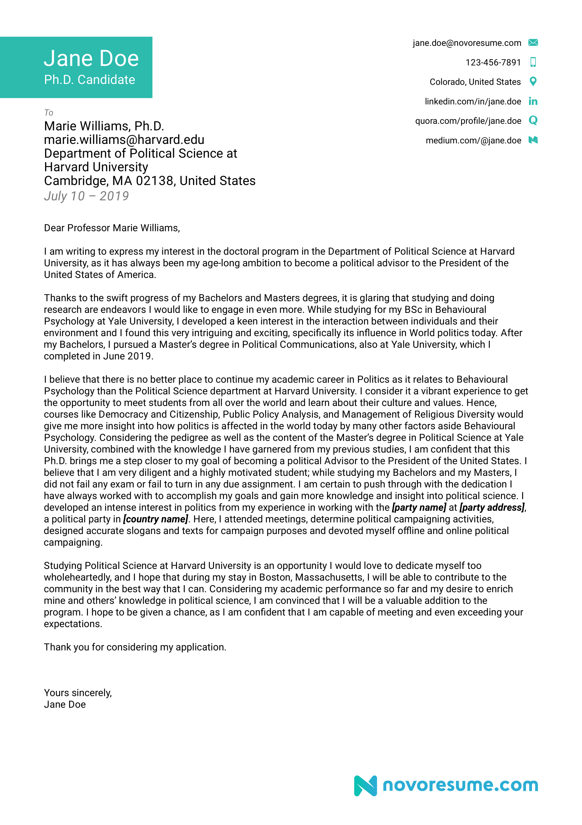

Slide 18
Advices
Cover the basics: The central function of a motivational letter is to convince the admissions team at the university of your choice to offer you a place, or invite you to interview. Make sure that the letter is structured in such a way that it serves this purpose – it is usual to conclude a motivational letter by asking directly that you be admitted or invited for interview, depending upon what the next step of the admissions process is. Equally important is the calibre of your written language; if your motivational letter is riddled with grammatical errors or spelling mistakes, or doesn’t make sense, the university will almost certainly refuse to admit you. A great starting point is to look at some templates for motivational letters in your chosen field, to see how they are structured, and what key points you need to cover.
Get personal: A standard for all cover letters – including those for job-seekers – is that you must address your letter to a specific person. For your masters course, it could be the Head of Department, or the academic staff member responsible for your masters study programme. If you will be working closely with an academic supervisor – as with most research degrees – your cover-letter should be addressed to the academic you’d prefer to supervise you. Use the university’s website to figure out who the right person is, and address the letter to them using their name and title.

Slide 19
Advices
Show, don’t tell: This is true of CVs, and is true of motivational letters too. “I am a good leader” sounds a lot weaker than “I led a group of my fellow students on a week long climbing expedition, where we successfully…”. Avoid any overly ambiguous statements, as these can diminish the confidence the admissions team may have in your motivations. Also, make sure not to show things twice – if you’ve discussed something extensively in your CV, don’t dwell on it in your motivational letter.
Do your research: Academic institutions often have a lot to say about their values, priorities and vision. What’s your target institution’s motto? Do they prioritise sports, arts, or something else? Do they have a statement of values? How do you reflect these things? The most important question to think about in relation to these things – why is it that you want to go here? Weaving your knowledge of these things into your letter is a great way to assure admissions tutors that your choice to study at their institution is an informed one.
Be specific: One of the biggest problems at application is that candidates don’t adequately explain why it is they want to study what they’ve applied for. Remember, you’ve got to explain your choice of subject, and your choice of institution. Not just “Why Biology?” but “Why Biology at this university?” If you don’t yet have answers to this question, then it is well worth going through the University’s website again, to work out what inspired you to take the next step, and apply for your chosen course.

Slide 20
Advices
Write a story: People love stories. They like to be taken on a journey, and brought to a satisfying conclusion. A list of superlatives or accomplishments is nowhere near as compelling as an epic story that weaves all that you’ve done into a coherent account, that supports the choice you’ve made to apply. Like all stories, make sure your motivational letter has a clear beginning, a middle, and an end. These should all follow logically on from one another, so that the reader is left feeling convinced of the suitability of your chosen course and institution, to your skills, experience, and goals.
Be interesting: This is without doubt the most important feature of a motivational letter – you absolutely must capture the reader’s interest. If you come across as boring (or worse, bored) on paper, it’s much less likely that you’ll get a positive reply. But furthermore, the interest you express has got to be personal, and it must relate directly to your motives. It’s absolutely no use whatever to produce some bland, boring page or two about hard work and how interested you are in your subject. This is exactly what every other candidate will write, and for the most competitive courses, you will want to stand out. But the best way to do this is not to try to be someone else; be yourself. Mention the fact that you like juggling. Talk about how you felt when your father was laid off work. Begin from your earliest memory. So long as what you say relates to what makes you the person you are, and then why that person has chosen to apply for this course, it deserves to be there.

Slide 21
Advices and References
What underscores all these points is a simple, and very ancient, piece of advice; know thyself.
Nobody expects you to have everything figured out when you apply for a masters, but they will at least expect you to have a firm grasp of what you want out of the degree you’ve chosen to apply for.
It’s in nobody’s interests for students to undertake courses for which they are ill-prepared, or that they haven’t really thought through – all you need to do is show your chosen university that this doesn’t apply to you.
How to Write a Resume [2019 Guide]
Cover Letter Examples [2019]
+150 Best Skills to Put On Your Resume [Guide & Infographic]
Resume Examples [2019] - Per Industry

Slide 22
Example 1: Motivation Letter for a Masters of Science Degree (MSc)
Dear sir /Madam,
My name is [name] and most recently I have been working as a [job title] at [company name]. I hold a B.Sc degree in [subject] from [university name].
The undergraduate curriculum in [subject], [university name], introduced me to a wide variety of subjects in the field of [subject]. Various courses like [course 1], [course 2], [course 3] (name all relevant courses) provided me with a strong footing in [subject of the masters degree].
While offering both depth and breadth across this field, these courses put into perspective the importance and relevance of [subject] and the application of its fundamentals to the problems faced by the real world.
I am much eager to adopt and know new technologies. I am really enthusiastic to attend a Master of [subject] at [university name] in order to understand different [subject] concepts and its applications to more complex real life situations. The good reputation of high-quality education standards, an extremely distinguished faculty members, and research facilities are the factors which have motivated me to apply for my masters studies at [university name].
Moreover, I feel I am responsible for making a big move in this field and this scholarship will give me a big chance to be one day someone who is remembered for his innovations. I think it is our duty as people sharing life in this world to make our future better because the future is not only ours. The next generation should be proud of us one day when they look back and find how hard we worked to make the world a better place. I believe my qualification and your needs would be an excellent fit. I will be happy to provide any further information or documents if required. I look forward to your positive response. Thank you for your time and consideration.
Kind regards,
Name

Slide 23
Samples of Motivation or cover letter
https://novoresume.com/career-blog/cover-letter-examples

Slide 24
What is difference between motivation and cover letter?
A cover letter technically refers to the accompanying letter you use when applying for a job.
A motivation letter is for applying to university or a non-paid position.
However, the word that most organisations will use for both criteria is the cover letter.

Slide 25
What is a cover letter?
A cover letter is an extension to your job application, it is not obligatory but including a well-written cover letter is strongly advised by all human resource experts. By definition, a cover letter is an accompanying, explanatory letter.
All jobseekers need a sales pitch of sorts, they need to hook the reader and demonstrate to the hiring manager why they are the right person for the vacancy on offer. This style of self marketing for a job application must come in the form of a winning resume and cover letter combination that complement one another.
A simple cover letter is an introduction to the candidate behind the qualifications and experience. The aim is to show a prospective employer how you can take on the role and what you can offer the company in question.
Cover letters generally follow a basic structure and can be in either hard or digital format, that is to say, either printed and sent via regular mail or as a document scanned and attached to send digitally, or written directly in an email cover letter.

